Slide 1
Microprocessors and Microcontrollers Lab
CSE 3118
LAB 3

Slide 2
Hardware Project Criteria
Must be beneficial to society
Should be budget friendly
Must be a team project
Each team member must contribute to the project

Slide 3
Hardware Requirements for Today’s Lab
Arduino
LED -> 1 piece
Resistance -> 1 piece
4x4 Keypad -> 1 piece
Buzzer -> 1 piece
Resistance -> 1 piece
Servo Motor -> 1 piece
Ultrasonic Sensor -> 1 piece
Wires -> As needed

Slide 4
What is Arduino?
Arduino is an open-source electronics platform based on easy-to-use hardware and software.
Arduino boards are able to read inputs - light on a sensor, and turn it into an output - activating a motor.
You can tell your board what to do by sending a set of instructions to the microcontroller on the board. To do so you use the Arduino programming language and the Arduino Software (IDE).

Slide 5
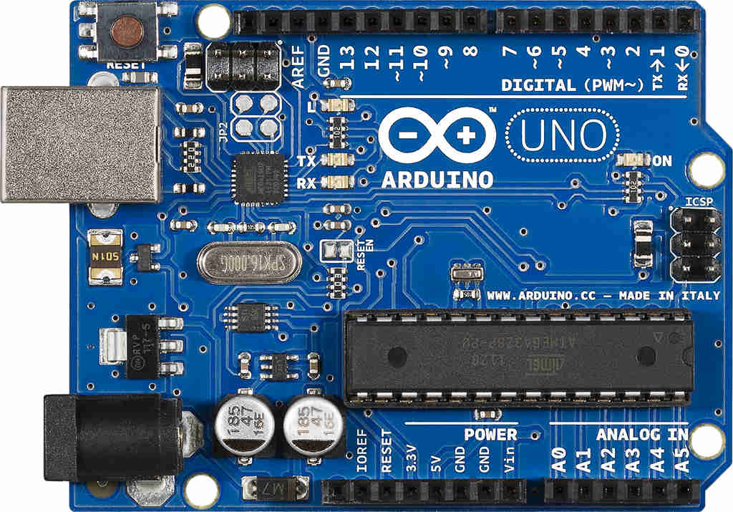
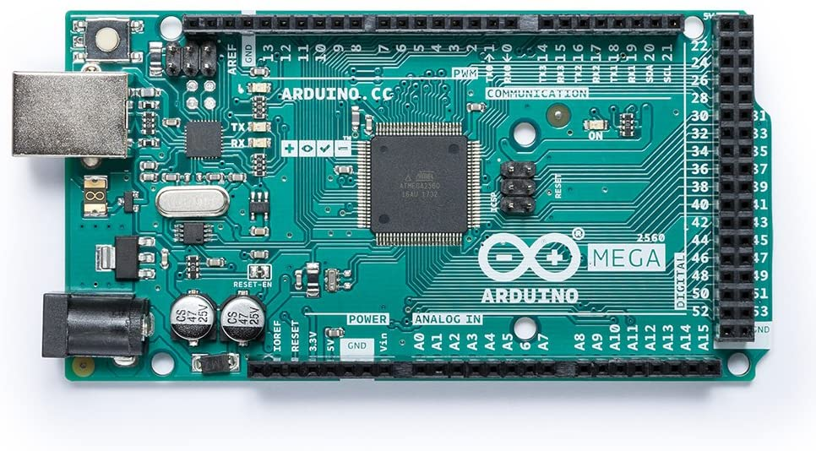
Different Types of Arduino Boards
Arduino UNO-> 14 digital pins, 6 analog pins
Arduino MEGA-> 54 digital pins, 16 analog pins

Slide 6
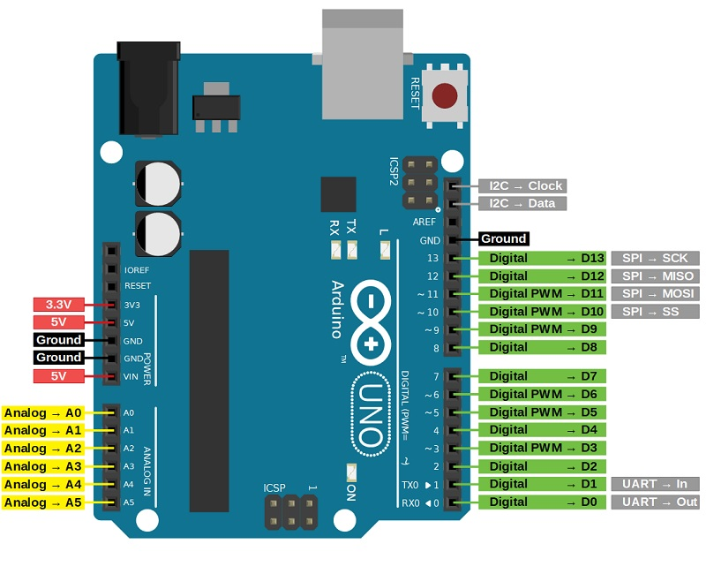
Arduino UNO Pin Diagram

Slide 7
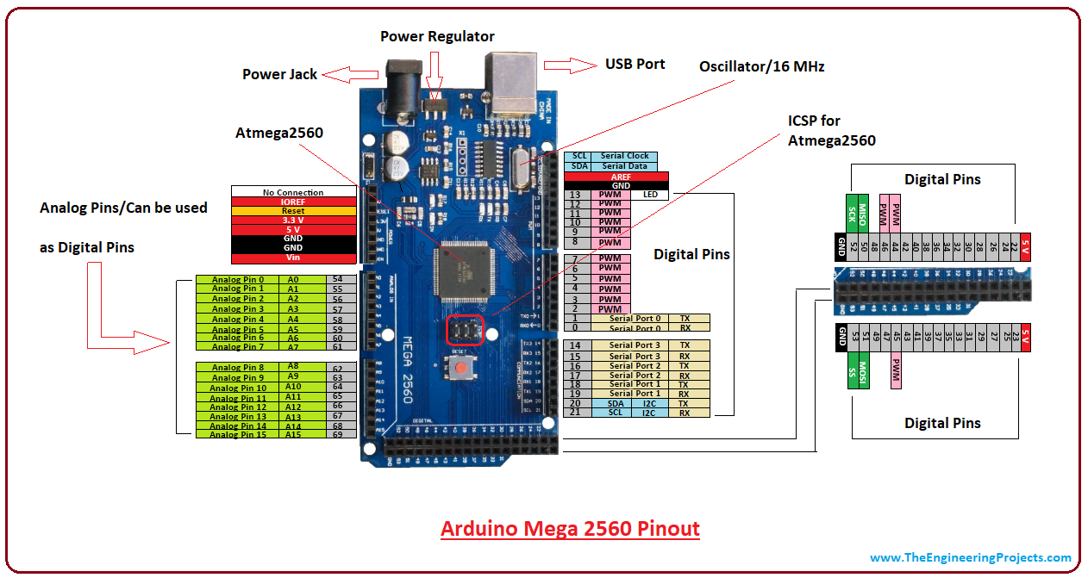
Arduino MEGA Pin Diagram

Slide 8
Arduino programming language
Arduino programming language can be divided in three main parts:
structure,
values (variables and constants), and
functions.

Slide 9
Structure of Arduino Code

Slide 10
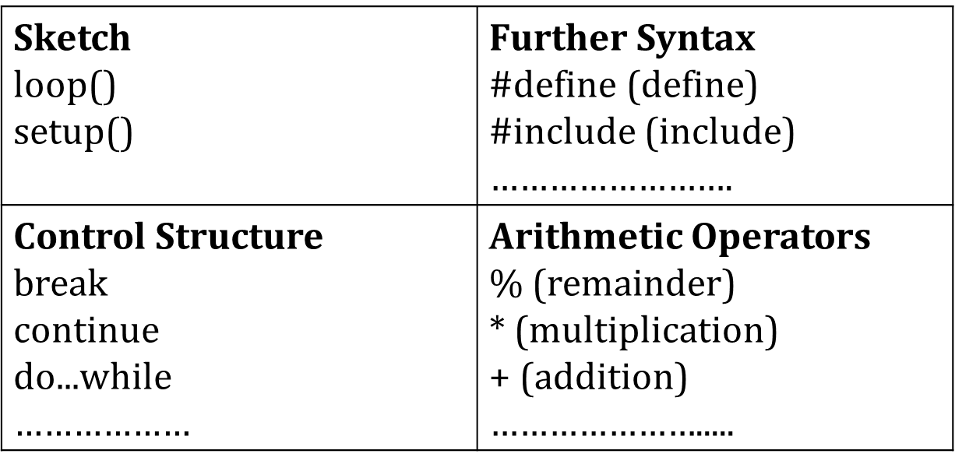
The elements/structure of Arduino (C++) code:

Slide 11
Functions of Arduino Code

Slide 12
FUNCTIONS of arduino
For controlling the Arduino board and performing computations.
Digital I/O
digitalRead() digitalWrite() pinMode()

Slide 13
digitalRead()
Description
Reads the value from a specified digital pin, either HIGH or LOW.
Syntax
digitalRead(pin)
Parameters
pin: the number of the digital pin you want to read
Returns
HIGH or LOW

Slide 14
digitalWrite()
Description
Write a HIGH or a LOW value to a digital pin.
Syntax
digitalWrite(pin, value)
Parameters
pin: the pin number
value: HIGH or LOW
Returns
Nothing

Slide 15
pinMode()
Description
Configures the specified pin to behave either as an input or an output.
Syntax
pinMode(pin, mode)
Parameters
pin: the number of the pin whose mode you wish to set
mode: INPUT, OUTPUT

Slide 16
Basic Arduino Code
The bare minimum of code needed to start an Arduino sketch.
void setup() {
// put your setup code here, to run once:
}
void loop() {
// put your main code here, to run repeatedly:
}

Slide 17
Blinking LED
int ledpin = 12;
void setup() {
pinMode(ledpin,OUTPUT);
}
void loop() {
digitalWrite(ledpin,HIGH);
delay(500);
digitalWrite(ledpin,LOW);
delay(500);
}

Slide 18
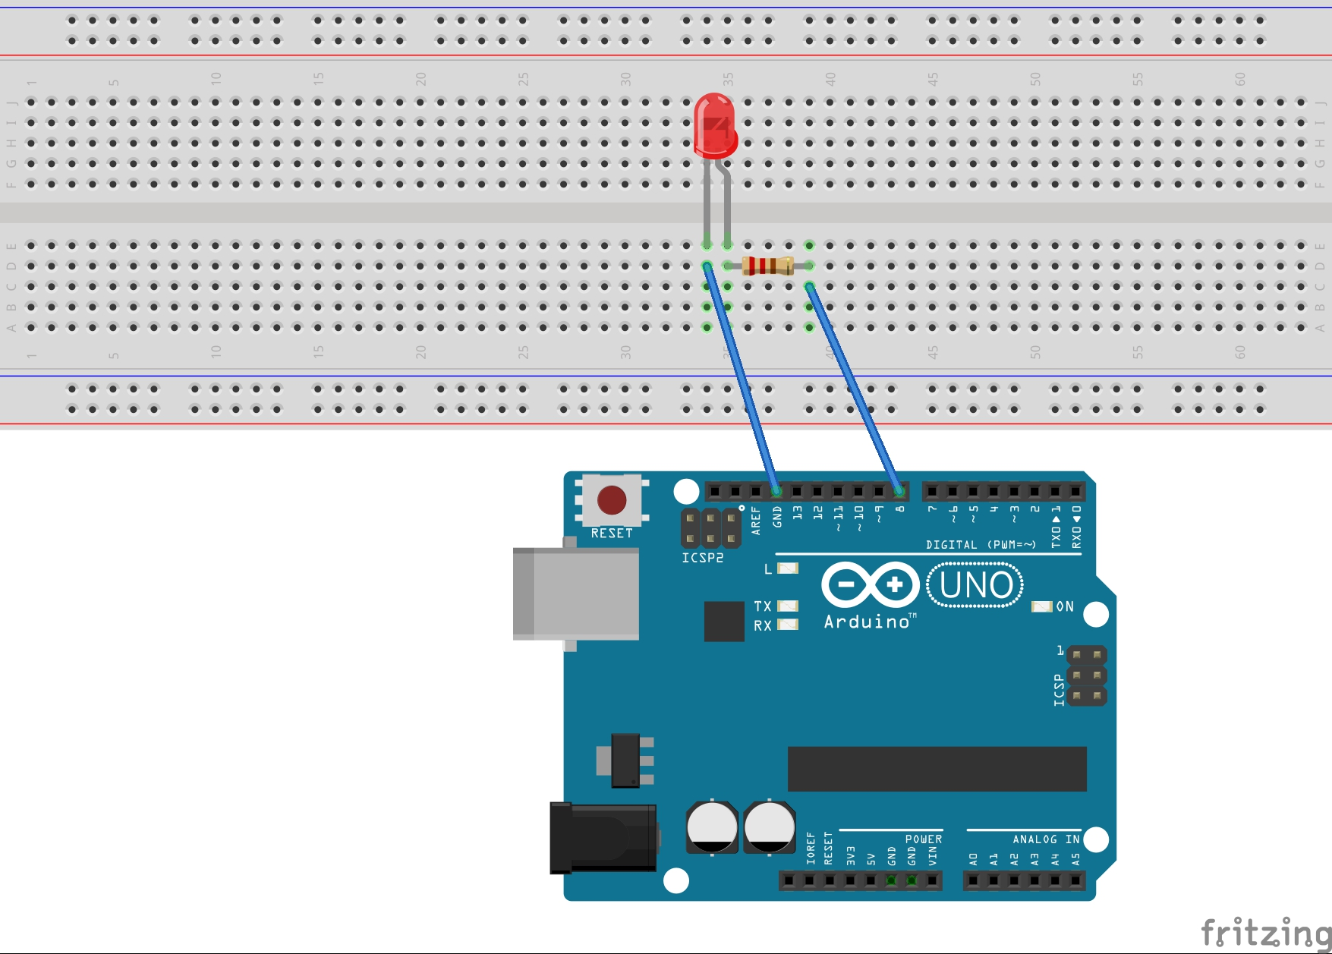
How to connect LED to Arduino UNO

Slide 19
Keypad

Slide 20
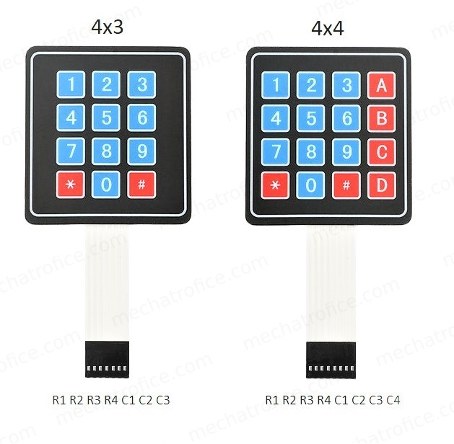
Keypad

Slide 21
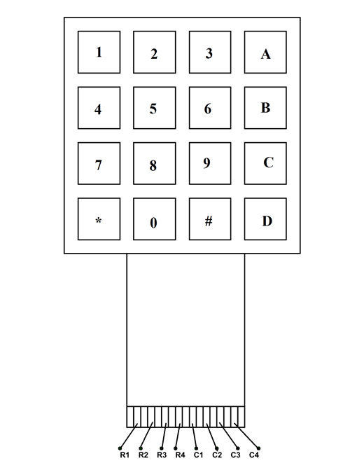
4x4 Keypad: Pin Layout
LEFT TO RIGHT->
1ST 4 PINS: ROWPINS
(R1, R2, R3, R4)
LAST 4 PINS: COLPINS
(C1, C2, C3, C4)

Slide 22
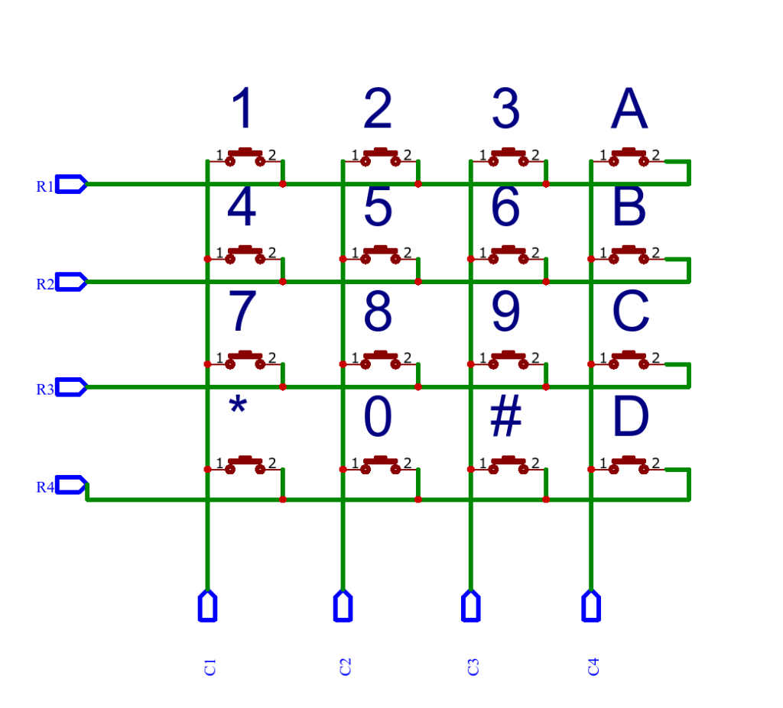
Keypad (contd)

Slide 23
Adding Libraries to Arduino
“Sketch” Button-> “Include Library”-> “Manage Libraries”-> Search for the library you need [in this case, “Keypad”]

Slide 24
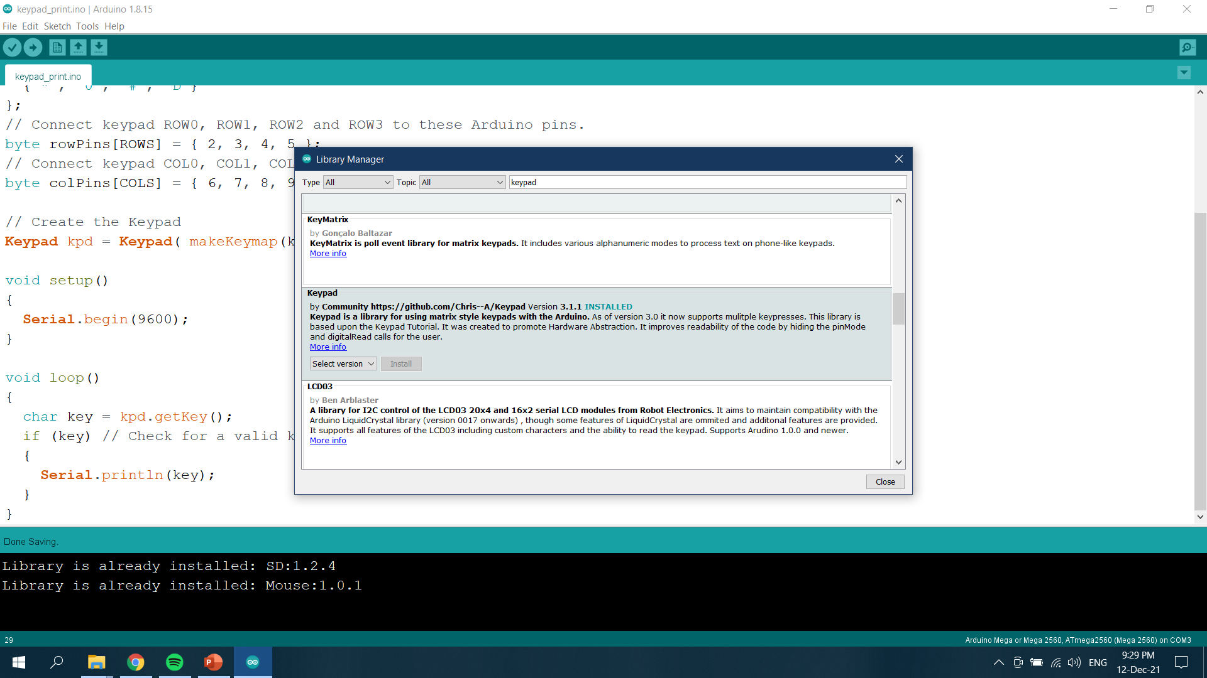

Slide 25
Keypad Functions
makeKeymap(keys): This function is used to initialize the internal keymap to be equal to the user defined key map.
Keypad kpd = Keypad(makeKeymap(keys), rowPins, colPins, rows, cols):
This defines an object kpd of the class Keypad and initializes it.
rowPins and colPins are the pins on Arduino to which the rows and columns of the keypad are connected to.
rows and cols are the number of rows and columns the keypad has.
kpd.getKey(): This function is used to identify which key is pressed on the keypad.

Slide 26
Serial Communication
Serial Communication: Used for communication between the Arduino board and a computer or other devices.
On Uno, Nano, Mini, and Mega, pins 0 and 1 are used for communication with the computer. Connecting anything to these pins can interfere with that communication, including causing failed uploads to the board.

Slide 27
Serial Functions
Serial.begin(): Sets the data rate in bits per second (baud) for serial data transmission. Typically, 9600 baud is used.
Syntax: Serial.begin(9600);
Serial.print(): Prints data to the serial port as human-readable ASCII text.
Syntax: Serial.print(“string”);
Serial.println(): Prints data to the serial port as human-readable ASCII text followed by a carriage return character ('\r') and a newline character ('\n').
Syntax: Serial.println(“string”);

Slide 28
Connection to Arduino
Connect the 1st four pins (from the left) to the rowPins mentioned in the Arduino code
Connect the last four pins to the colPins mentioned in the Arduino code

Slide 29
Arduino Code
#include <Keypad.h>
const byte ROWS = 4; // Four rows
const byte COLS = 4; // Four columns
char keys[ROWS][COLS] = {
{'1', '2', '3', 'A'},
{'4', '5', '6', 'B'},
{'7', '8', '9', 'C'},
{'*', '0', '#', 'D'}
};
// Connect keypad ROW0, ROW1, ROW2 and ROW3 to these Arduino pins.
byte rowPins[ROWS] = { 2, 3, 4, 5 };
// Connect keypad COL0, COL1, COL2 and COL3 to these Arduino pins.
byte colPins[COLS] = { 6, 7, 8, 9};

Slide 30
Arduino Code(contd)
// Create the Keypad
Keypad kpd = Keypad( makeKeymap(keys), rowPins, colPins, ROWS, COLS );
void setup()
{
Serial.begin(9600);
}
void loop()
{
char key = kpd.getKey();
if (key) // Check for a valid key.
{
Serial.println(key);
}
}

Slide 31
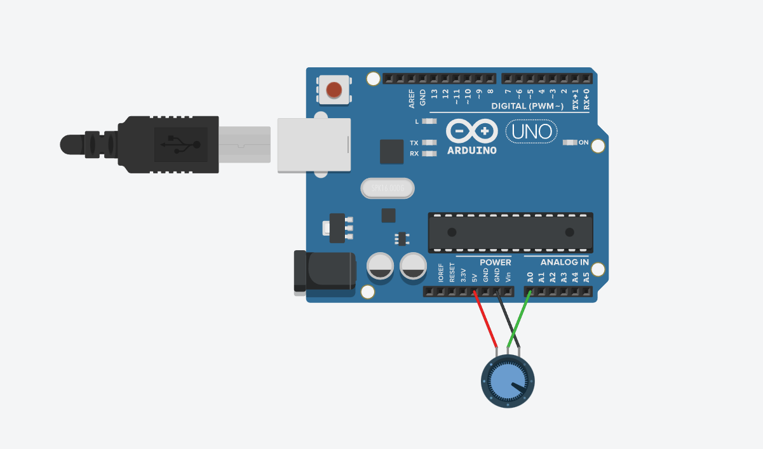
Printing Pot value to Serial Monitor

Slide 32
Code
int sensorValue = 0;
void setup()
{
pinMode(A0, INPUT);
Serial.begin(9600);
}
void loop()
{
// read the input on analog pin 0:
sensorValue = analogRead(A0);
// print out the value you read:
Serial.println(sensorValue);
delay(10); // Delay a little bit to improve simulation performance
}

Slide 33
Buzzer

Slide 34
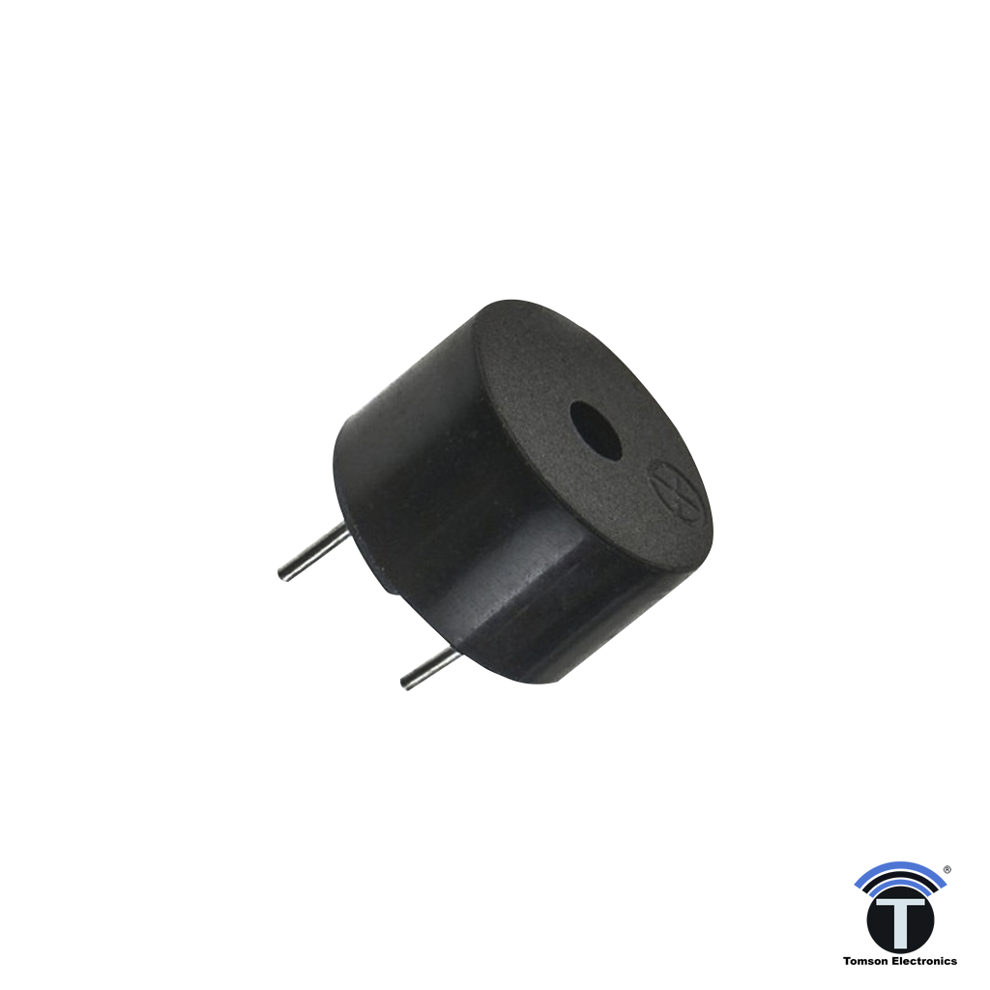
Buzzer
Piezo buzzer is an electronic device commonly used to produce sound.
Piezo buzzer is based on the inverse principle of piezo electricity discovered in 1880 by Jacques and Pierre Curie. It is the phenomena of generating electricity when mechanical pressure is applied to certain materials and the vice versa is also true. Such materials are called piezo electric materials.

Slide 35
Buzzer(contd)
Piezoceramic is class of manmade piezoelectric material, which poses piezo electric effect and is widely used to make “disc”, the heart of piezo buzzer. When subjected to an alternating electric field they stretch or compress, in accordance with the frequency of the signal thereby producing sound.

Slide 36
Buzzer Functions
tone():
Description
Generates a square wave of the specified frequency on a pin. A duration can be specified, otherwise the wave continues until a call to noTone().
Syntax
tone(pin, frequency)
tone(pin, frequency, duration)
Parameters
pin: the Arduino pin on which to generate the tone.
frequency: the frequency of the tone in hertz. Allowed data types: unsigned int.
duration: the duration of the tone in milliseconds (optional). Allowed data types: unsigned long.

Slide 37
Buzzer Functions
noTone():
Description
Stops the generation of a square wave triggered by tone(). Has no effect if no tone is being generated.
Syntax
noTone(pin)
Parameters
pin: the Arduino pin on which to stop generating the tone

Slide 38
Connection to Arduino
Connect the positive pin of the buzzer to the Digital Pin (no. mentioned in the code) of the Arduino through a small valued resistor.
Connect the negative/ground pin of the buzzer to any Ground Pin on the Arduino.

Slide 39
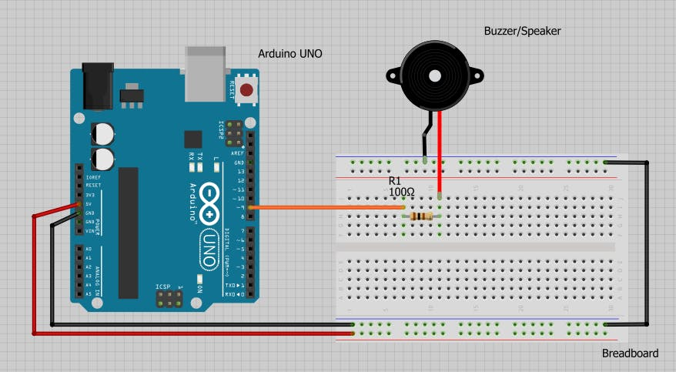

Slide 40
Arduino Code
int buzzer = 9; //buzzer to arduino pin 9
void setup(){
pinMode(buzzer, OUTPUT); // Set buzzer - pin 9 as an output
}
void loop(){
tone(buzzer,1000); // Send 1KHz sound signal...
delay(1000); // ...for 1 sec
noTone(buzzer); // Stop sound...
delay(1000); // ...for 1sec
}

Slide 41
Servo Motor

Slide 42
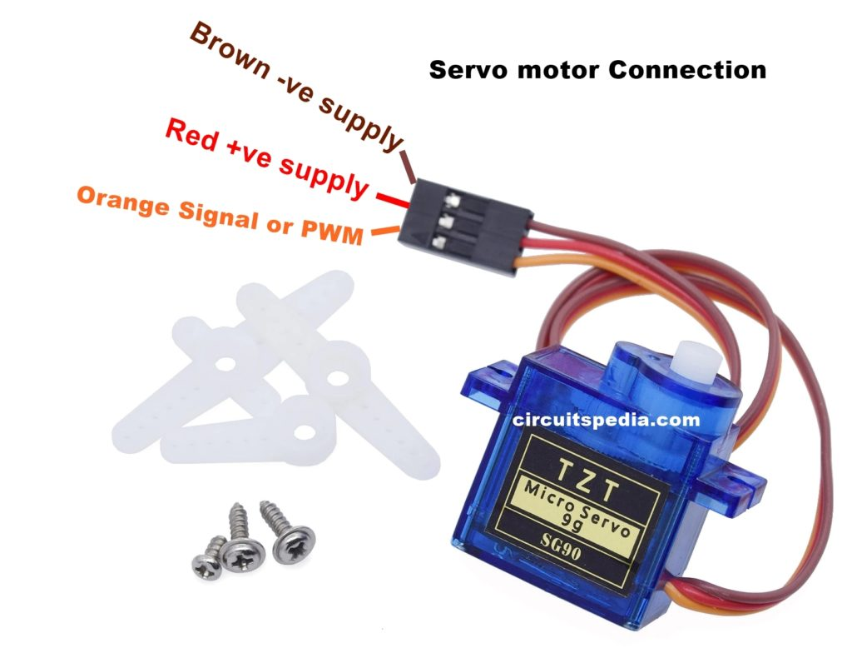
Servo Motor

Slide 43
Servo Motor(contd)
Rotation Range: 180° (-90° to +90°)
Consists of:
DC Motor,
Gear system,
Position sensor, and
Control circuit
Degree of rotation can be controlled by applying the Electrical Pulse of proper width, to its Control pin.

Slide 44
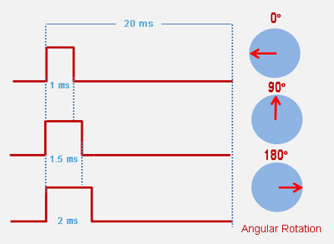
Servo Motor(contd)

Slide 45
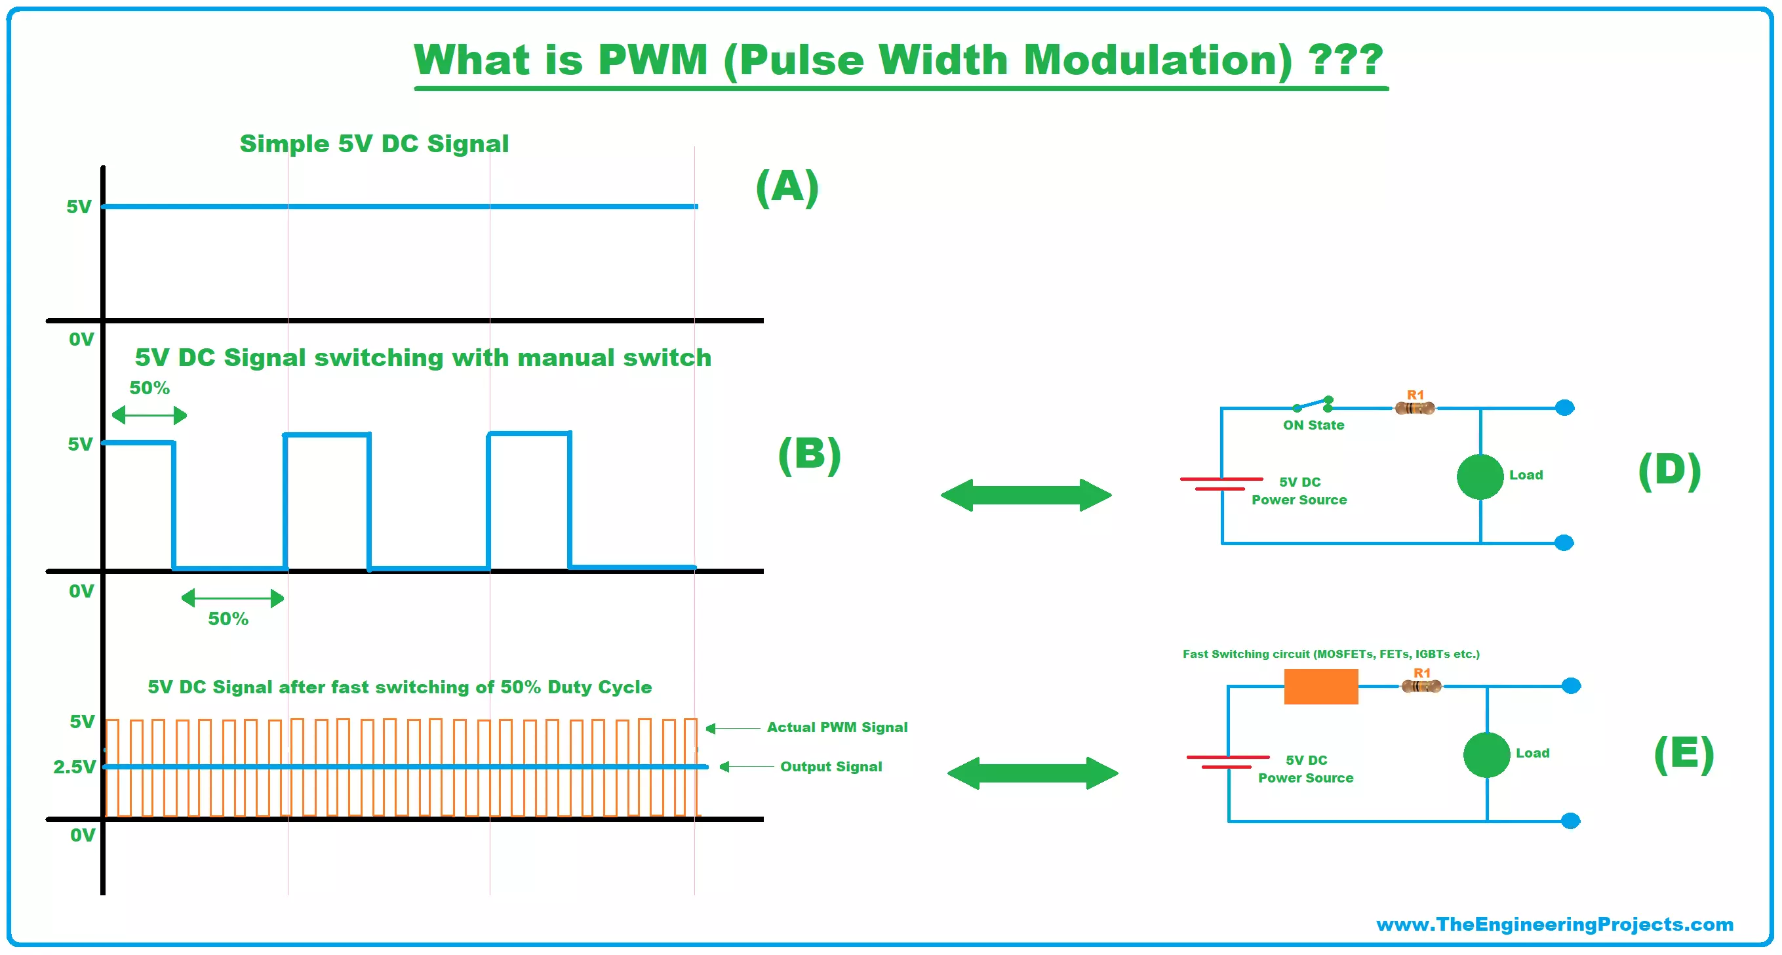
Servo Motor(contd)
3 wires:
Red: Positive
Brown/Black: GND
Yellow/Orange: Signal/PWM

Slide 46
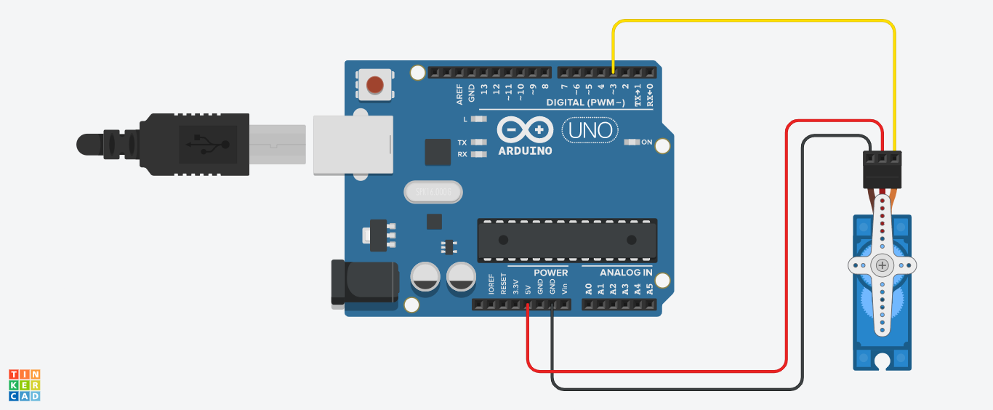
Servo Motor Arduino Connection

Slide 47
Servo Motor Arduino Code
#include <Servo.h>
Servo servo;
int angle = 10;
void setup() {
servo.attach(8); //attached to a pin
servo.write(angle);
}
void loop()
{
for(angle = 10; angle < 180; angle++)
{
servo.write(angle);
delay(15);
}
for(angle = 180; angle > 10; angle--)
{
servo.write(angle);
delay(15);
}
}

Slide 48
Ultrasonic Sensor

Slide 49
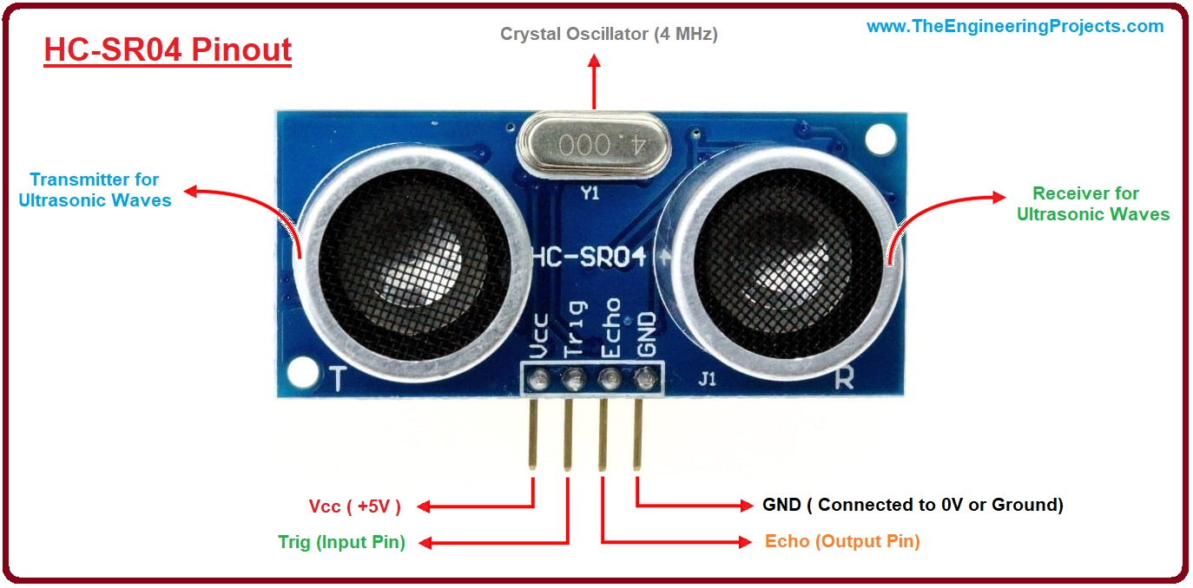
ULTRASONIC SENSOR: 4 pin

Slide 50
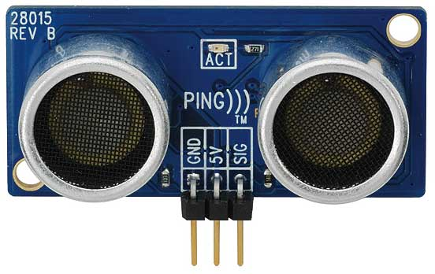
ULTRASONIC SENSOR: 3 pin

Slide 51
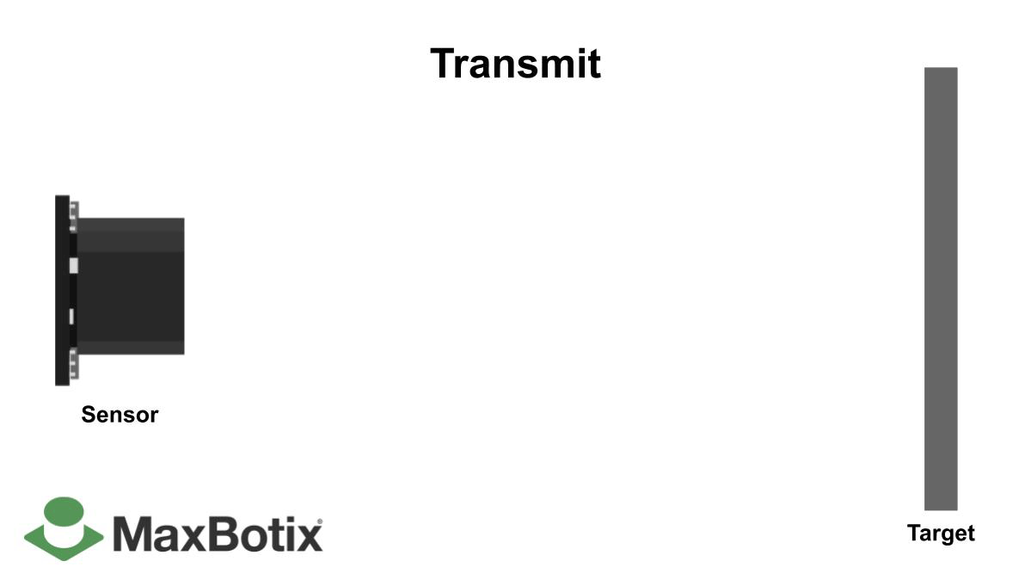
ULTRASONIC SENSOR (HC SR-04)

Slide 52
ULTRASONIC SENSOR: 4 pin
4 pins: positive voltage(Vcc), ground(GND), trigger pin and echo pin
Consists of: two ultrasonic transducers (one for transmission and one for reception)
Ultrasound: high-pitched sound waves with frequencies higher than the audible limit of human hearing i.e. higher than 20 KHz
Model HC SR-04 converts electrical signal into 40 KHz ultrasonic sound pulses
Detection Range: 2 cm-4 meter

Slide 53
ULTRASONIC SENSOR: 4 pin
Trig (Trigger) pin: Used to trigger the ultrasonic sound pulses.
Echo pin: Produces a pulse when the reflected signal is received. The length of the pulse is proportional to the time it took for the transmitted signal to be detected.

Slide 54
ULTRASONIC SENSOR: 3 pin
3 pins: positive voltage(Vcc), ground(GND), signal pin
Consists of: two ultrasonic transducers (one for transmission and one for reception)

Slide 55
ULTRASONIC SENSOR: 3 pin
Signal pin: Combines the functionality of trigger pin and echo pin.

Slide 56
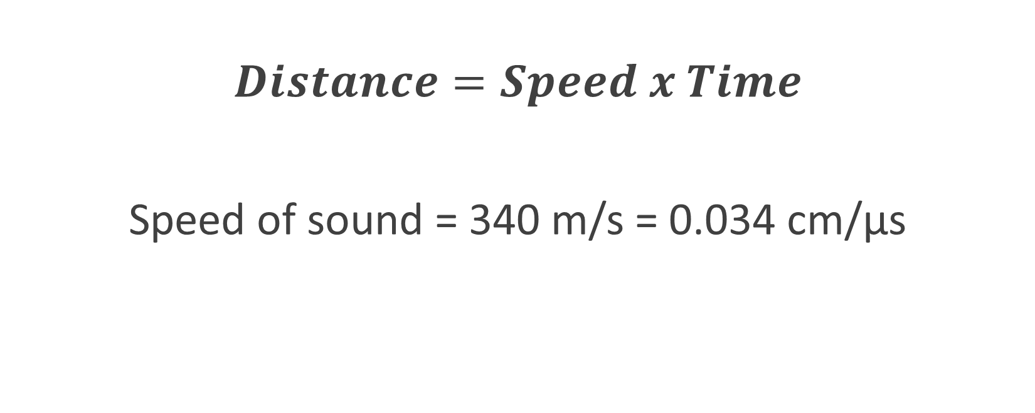
ULTRASONIC SENSOR Formula
$$Distance=Speed x Time$$
Speed of sound = 340 m/s = 0.034 cm/μs

Slide 57
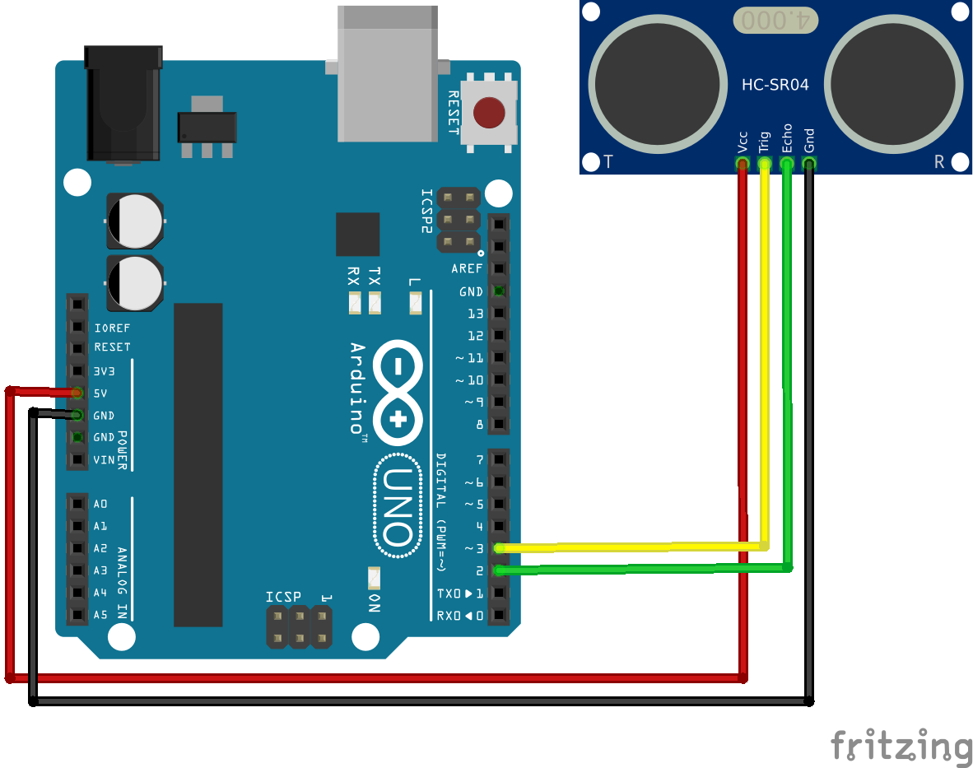
Ultrasonic Sensor Arduino Connection

Slide 58
Ultrasonic Sensor Arduino Code: 4 pin
const int trigPin = 9;
const int echoPin = 10;
long duration;
int distance;
void setup() {
pinMode(trigPin, OUTPUT);
pinMode(echoPin, INPUT);
Serial.begin(9600);
}
void loop() {
digitalWrite(trigPin, LOW); //clear trigger pin
delay(2);
digitalWrite(trigPin, HIGH);
delay(10); // Set trigPin on HIGH state for 10 micro seconds
digitalWrite(trigPin, LOW);
duration = pulseIn(echoPin, HIGH); // Reads the echoPin, returns the sound wave travel time in microseconds
distance= (duration*0.034)/2;
Serial.print("Distance(cm): ");
Serial.println(distance);
delay(1000);
}

Slide 59
Ultrasonic Sensor Arduino Code: 3 pin
const int sigPin = 9;
long duration;
int distance;
void setup() {
Serial.begin(9600);
}
void loop() {
pinMode(sigPin, OUTPUT);
digitalWrite(sigPin, LOW);
delay(2);
digitalWrite(sigPin, HIGH);
delay(10);
digitalWrite(sigPin, LOW);
pinMode(sigPin, INPUT);
duration = pulseIn(echoPin, HIGH);
distance= (duration*0.034)/2;
Serial.print("Distance(cm): ");
Serial.println(distance);
delay(1000);
}

Slide 60
Infrared Sensor (Active)

Slide 61
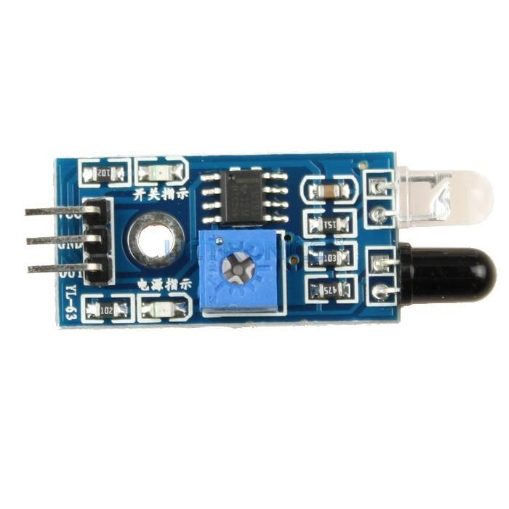
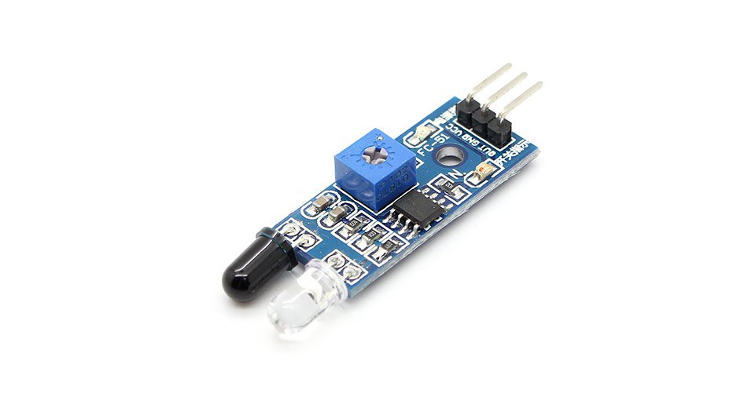
IR SENSOR

Slide 62
IR SENSOR
3 pins: positive voltage(+Vcc), ground(GND) and output voltage(Vout)
Emits light in order to sense surrounding objects
Consists of: emitter(IR source) and detector(IR detector)
Emitter: IR LED-> Emits IR light
Detector: IR photodiode-> Sensitive to IR light of the same wavelength which is emitted by the IR LED
Output determined based on intensity of reflection received by photodiode
Output is binary

Slide 63
IR SENSOR
IR Transmitter or IR LED
IR Receiver or Photodiode

Slide 64
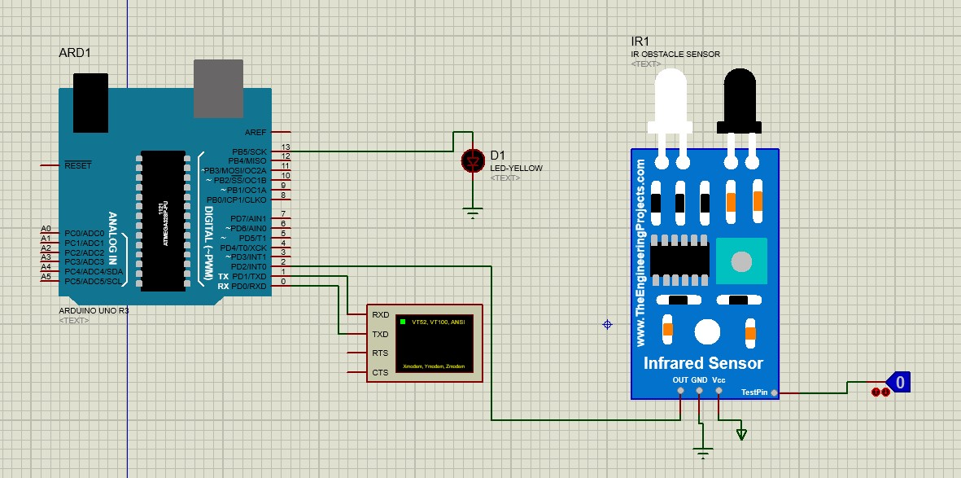
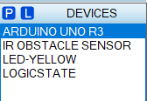
Proteus Connection
Components Needed:

Slide 65
Code
int IRSensor = 2; // connect ir sensor to arduino pin 2
int LED = 13; // connect Led to arduino pin 13
void setup()
{
Serial.begin(9600);
pinMode (IRSensor, INPUT); // sensor pin INPUT
pinMode (LED, OUTPUT); // Led pin OUTPUT
}
void loop()
{
int sensor_status = digitalRead (IRSensor);
//OUTPUT HIGH=NO OBSTACLE
if (sensor_status == 1) {
digitalWrite(LED, LOW); // LED OFF
Serial.println("No Obstacle Detected");
delay(1000);
}
else
{
digitalWrite(LED, HIGH); // LED ON
Serial.println("Obstacle Detected");
delay(1000);
}
}

Slide 66
Infrared Sensor (Passive)

Slide 67
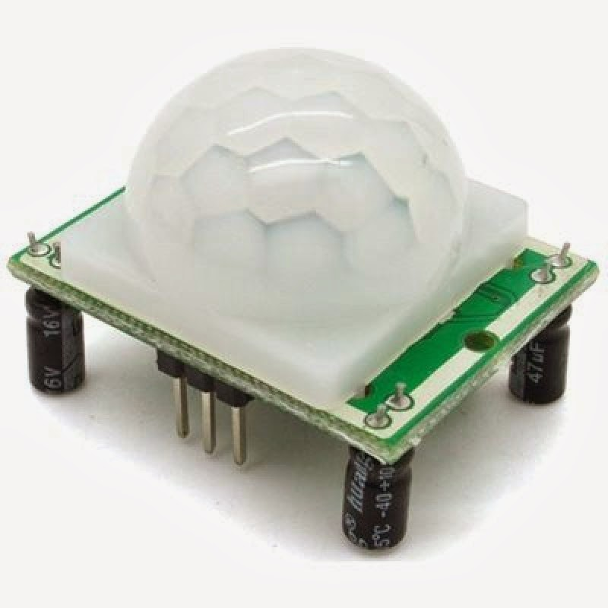
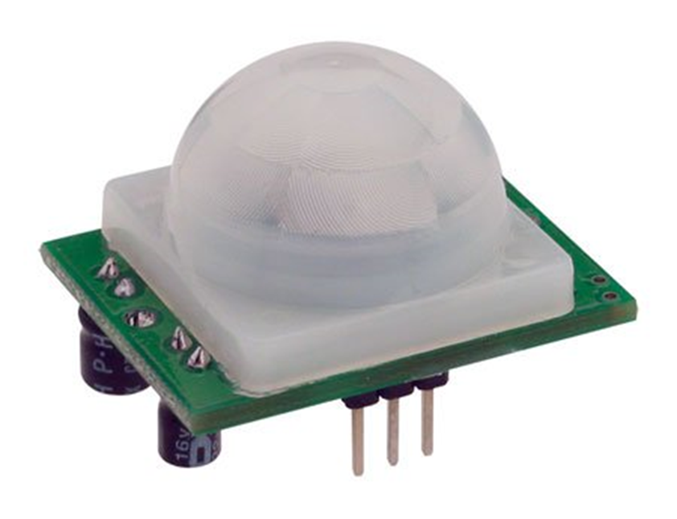
PIR SENSOR

Slide 68
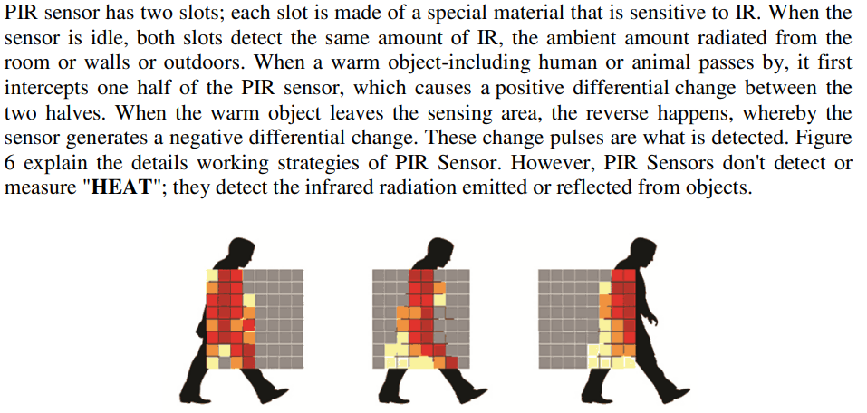
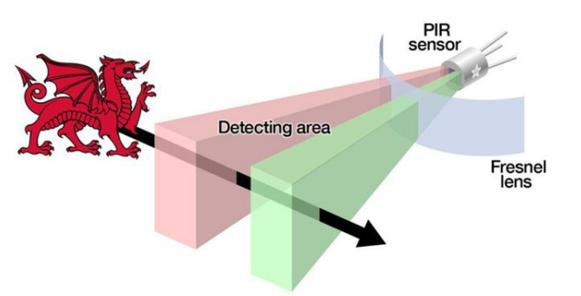
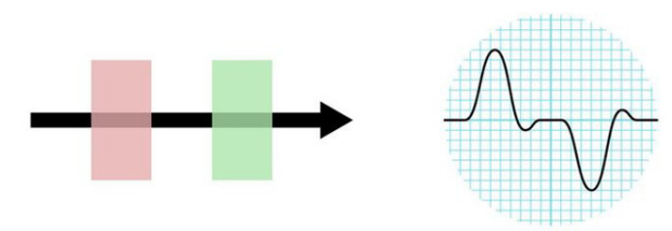

Slide 69
PIR SENSOR
3 pins: positive voltage(+Vcc), ground(GND) and output signal (Vout)
Can detect thermal radiation of objects in the infrared range
Consists of: 1 pair of pyroelectric sensors, to detect heat energy in the surrounding environment
Sensors housed within a series of lenses
Purpose of lens: widening the device’s sensing area
Output is binary

Slide 70
IR vs. PIR: COMPARISON
IR SENSOR
PIR SENSOR
Contains active emitter
Capable of detecting exact position of objects
Used in: garage door systems, industrial settings
No active emitter
Capable of detecting motion
Used in: security alarms and automatic lighting setups

Slide 71
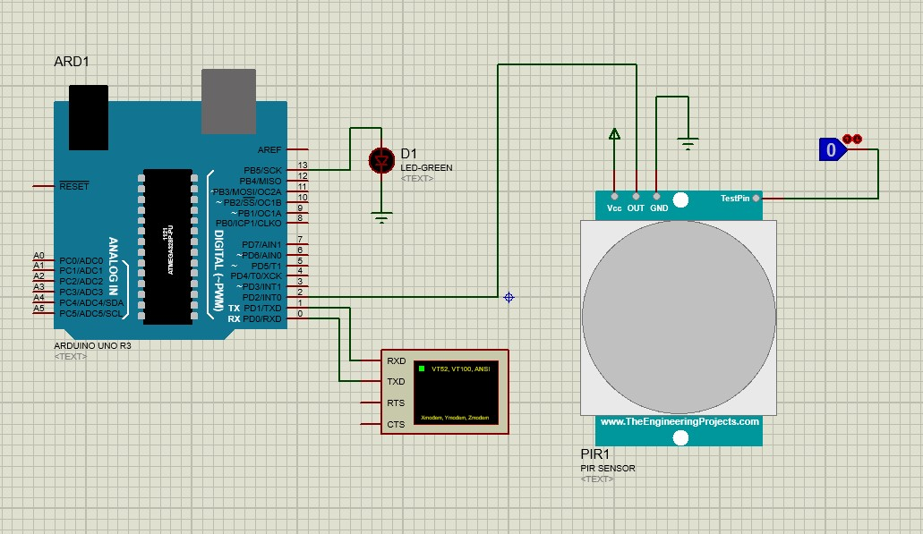
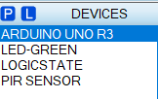
Proteus Connection
Components Needed:

Slide 72
Code
int ledPin = 13; // LED
int pirPin = 2; // PIR Out pin
int pirStat = 0; // PIR status
void setup() {
pinMode(ledPin, OUTPUT);
pinMode(pirPin, INPUT);
Serial.begin(9600);
}
void loop(){
pirStat = digitalRead(pirPin);
if (pirStat == HIGH) { // if motion detected
digitalWrite(ledPin, HIGH); // turn LED ON
Serial.println("Motion Detected");
delay(1000);
}
else {
digitalWrite(ledPin, LOW); // turn LED OFF if we have no motion
Serial.println("No Motion Detected");
delay(1000);
}
}

Slide 73
LCD (Liquid Crystal Display)

Slide 74
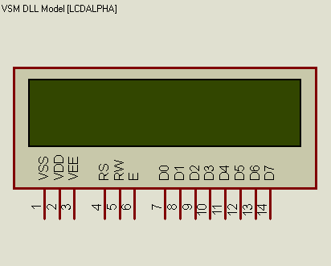
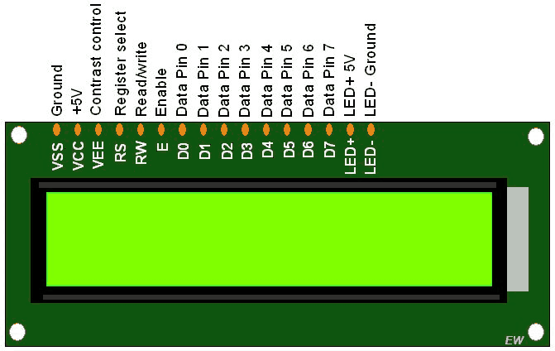
LCD
LM016L Model
LCD Model we will use in proteus
LCD Model with Pin Description

Slide 75
Pin No.-> Pin Name | Pin Description | Pin Connection
1-> VSS | Ground Pin | Connect to ground
2-> VDD | VCC pin(for power) | Connect to power supply i.e. 5V
3-> VEE | Adjusts contrast of LCD | Could be connected to a variable POT that can vary the voltage between 0 to 5V, but here we will simply connect it to 5V
4-> RS | Register Select: Toggles between Command/Data Register | Connected to an Arduino pin and gets either 0 or 1. 0 -> Command Mode 1-> Data Mode
5-> RW | Read/Write: Toggles the LCD between Read/Write Operation | If connected to an Arduino pin, it will get either 0 or 1. 0 -> Write Operation 1-> Read Operation However, as Read operation is rarely needed, we typically directly connect it to GND so it will always get 0.
6-> E | Enable: Must be held high to perform Read/Write Operation | Connected to an Arduino pin and always gets 1(HIGH).
(7-14)-> (D0-D7) | Data Bits (0-7): Pins used to send Command or data to the LCD. | In 4-Wire Mode Only 4 pins (0-3) is connected to Arduino In 8-Wire Mode All 8 pins(0-7) are connected to Arduino
15-> LED + [Not present in the model we are using] | LED Positive: used to turn on/off backlight of the LCD | Connect to power supply i.e. 5V [not needed here]
16-> LED - [Not present in the model we are using] | LED Negative: used to turn on/off backlight of the LCD | Connect to ground [not needed here]

Slide 76
LCD (contd.)
4-bit and 8-bit Mode of LCD:
The LCD can work in two different modes, namely the 4-bit mode and the 8-bit mode.
In 4 bit mode we send the data nibble by nibble, first upper nibble and then lower nibble. A nibble is a group of four bits, so the lower four bits (D0-D3) of a byte form the lower nibble while the upper four bits (D4-D7) of a byte form the higher nibble. This enables us to send 8-bit data.
Whereas in 8-bit mode we send data byte by byte, so we can send the 8-bit data directly in one stroke since we use all the 8 data lines.
8-bit mode is faster and flawless than 4-bit mode. But the major drawback is that it needs 8 data lines connected to the microcontroller. This will make us run out of I/O pins on our Arduino board, so 4-bit mode is widely used. No control pins are used to set these modes. It's just the way of programming that change.

Slide 77
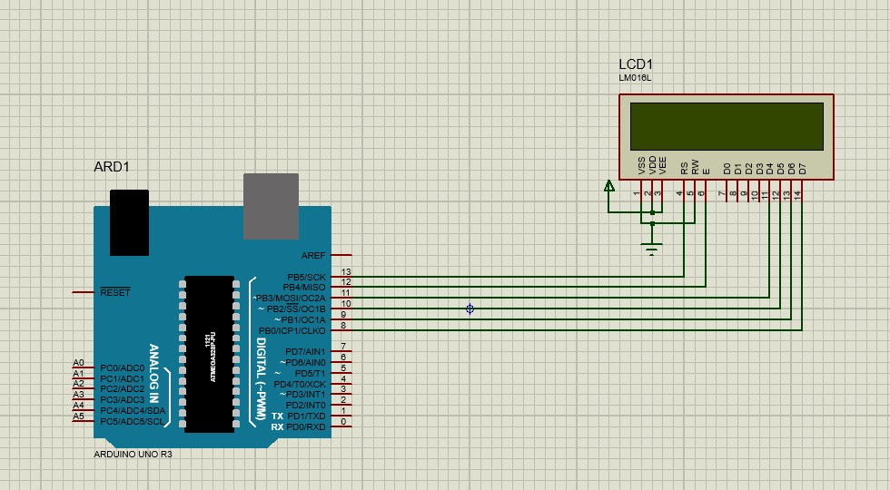
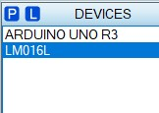
Proteus Connection
Components Needed:

Slide 78
Code for LCD
#include <LiquidCrystal.h>
// initialize the library with the numbers of the interface pins
//LiquidCrystal lcd(rs, en, d4, d5, d6, d7);
LiquidCrystal lcd(13, 12, 11, 10, 9, 8);
void setup() {
// set up the LCD's number of columns and rows:
lcd.begin(16, 2);
lcd.setCursor(0,0);
lcd.clear();
lcd.print("Loading/Initializing");
// Print a message to the LCD.
}
void loop() {
// set the cursor to column 0, line 1
// (note: line 1 is the second row, since counting begins with 0):
lcd.setCursor(0, 1);
// print the number of seconds since reset:
delay(3000);
lcd.print("MSD Lab");
delay(2000);
lcd.clear();
delay(2000);
lcd.print("Cursor Blink");
lcd.blink();
delay(2000);
lcd.clear();
lcd.print("U_cursor");
lcd.cursor();
delay(2000);
lcd.clear();
lcd.print("No cursor");
lcd.noCursor();
delay(2000);
lcd.clear();
lcd.print("Resume");
lcd.display();
delay(2000);
lcd.clear();
}

Slide 79
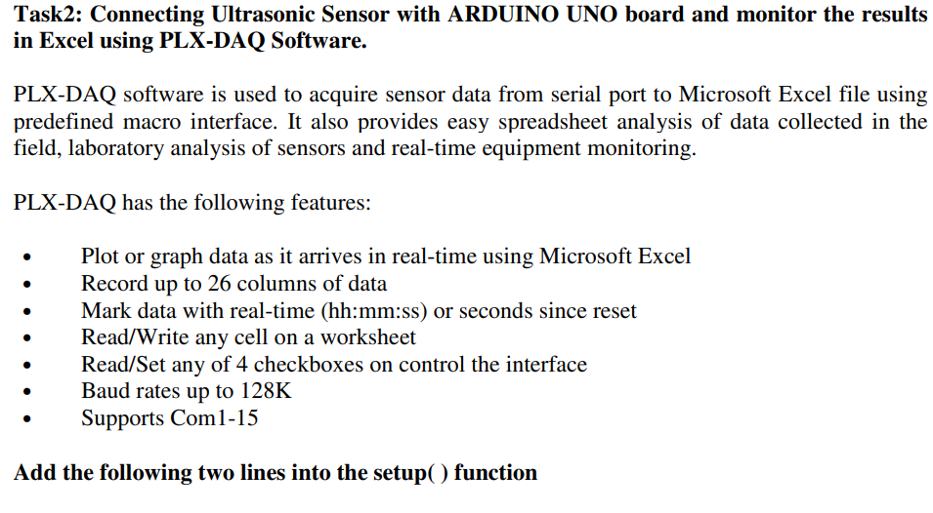

Slide 80
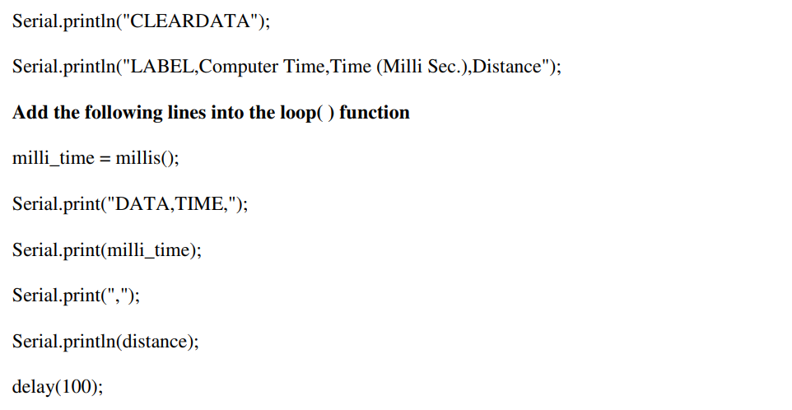

Slide 81
Temperature Sensor

Slide 82
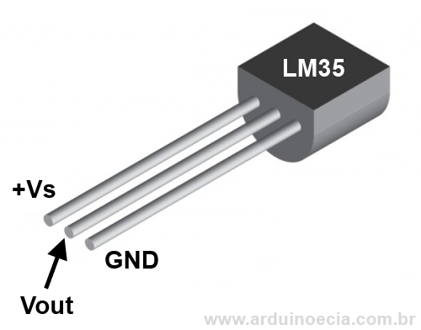
TEMPERATURE SENSOR (LM-35)

Slide 83
TEMPERATURE SENSOR
3 pins: positive voltage(+Vs), ground(GND) and output voltage(Vout)
Output voltage is linearly proportional to the Celsius (Centigrade) temperature
−55˚ to +150˚C temperature range [LM35]
−40˚ to +125˚C temperature range [TMP36]
+ 10.0 mV per 1˚C scale factor

Slide 84
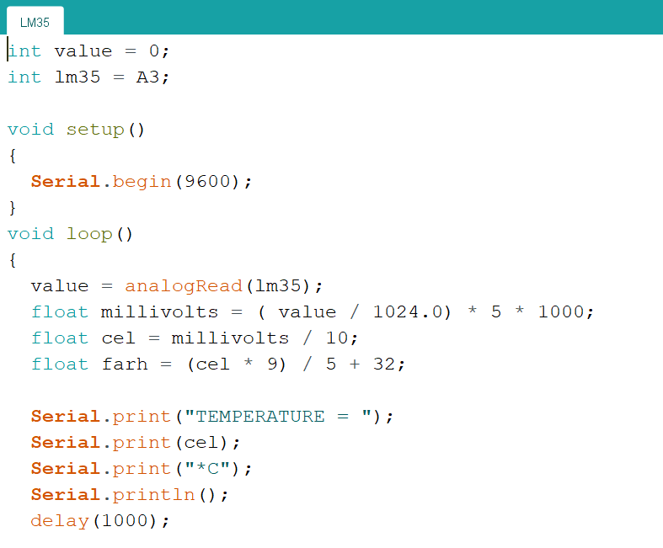
TEMPERATURE SENSOR (LM-35)
Arduino Uno/Mega uses 10-bit analog-to-digital converter
Arduino maps input voltages between 0 and the operating voltage(5V, in case of Uno/Mega) into integer values between 0 to 1023
analogRead()-> gives integer value within 0-1023
To get back the value in volt, we must divide the value by 1024 and multiply it by 5
Scale factor: + 10.0 mV => 1˚C

Slide 85
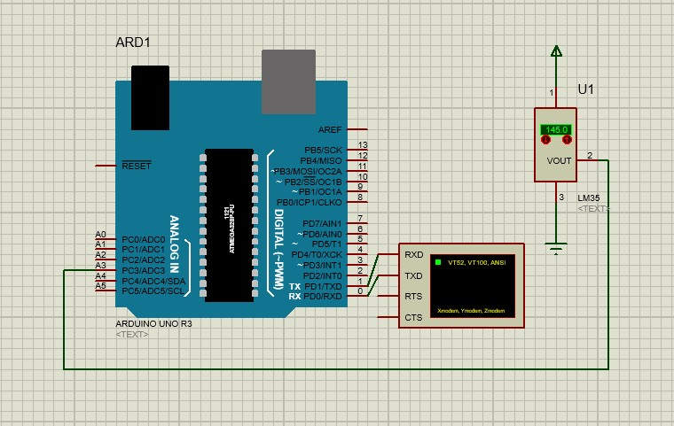
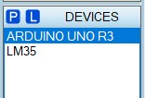
Proteus Connection
Components Needed:

Slide 86
Code
int value = 0;
int lm35 = A3;
void setup()
{
Serial.begin(9600);
}
void loop()
{
value = analogRead(lm35);
float millivolts = ( value / 1024.0) * 5 * 1000;
float cel = millivolts / 10;
float farh = (cel * 9) / 5 + 32;
Serial.print("TEMPERATURE = ");
Serial.print(cel);
Serial.print("*C");
Serial.println();
delay(1000);
Serial.print("TEMPERATURE = ");
Serial.print(farh);
Serial.print("*F");
Serial.println();
delay(1000);
}

Slide 87
DC Motor

Slide 88
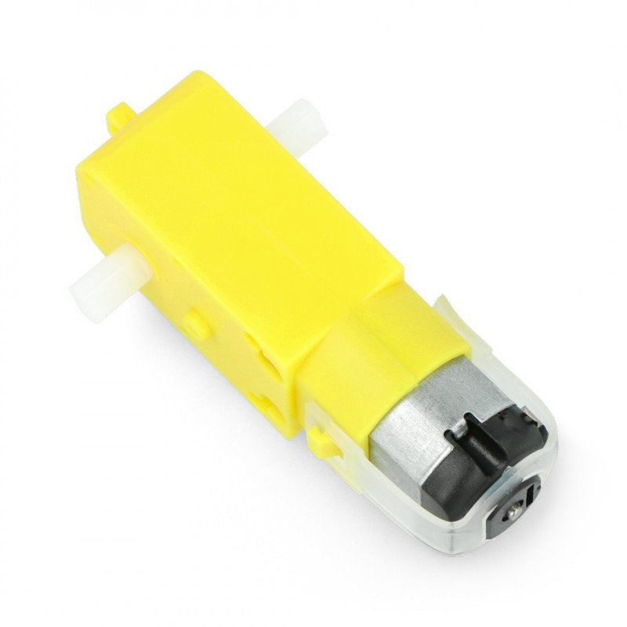
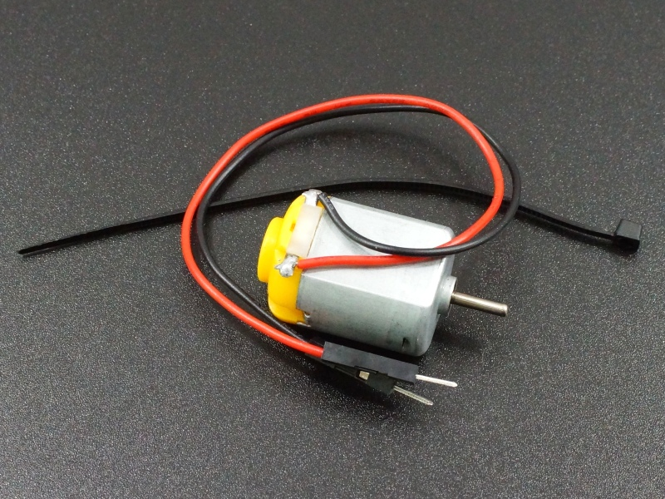
DC Motor

Slide 89
DC Motor(contd)
A direct current (DC) motor is a type of electric machine that converts electrical energy into mechanical energy. DC motors take electrical power through direct current, and convert this energy into mechanical rotation.
DC motors use magnetic fields that occur from the electrical currents generated, which powers the movement of a rotor fixed within the output shaft. The output torque and speed depends upon both the electrical input and the design of the motor.

Slide 90
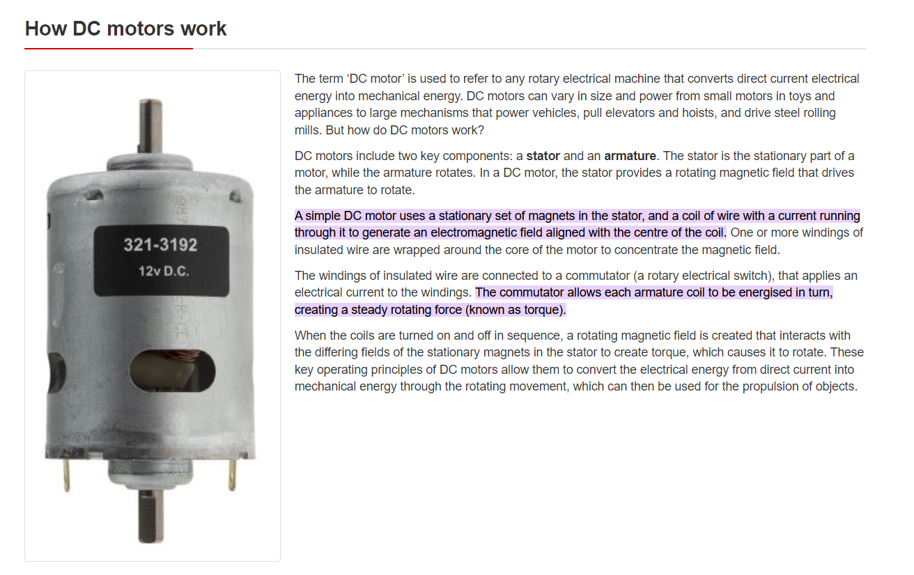
How DC motors work
Reference: https://ie.rs-online.com/web/generalDisplay.html?id=ideas-and-advice/dc-motors-guide#:~:text=A%20simple%20DC%20motor%20uses,the%20centre%20of%20the%20coil.&text=The%20commutator%20allows%20each%20armature,force%20(known%20as%20torque).

Slide 91
Types of DC Motors
Brushed DC Motor:-
The brushed DC motor is the original DC motor. Brushed DC motors utilise soft contacts known as ‘brushes’ to ensure the motor rotates in one direction. Brushed motors’ speed can be varied by the operating voltage or the strength of the magnetic field.
The ‘brushes’ wear down over time. A brushless DC motor is therefore more durable, and also safer than the more classical design.
Brushless DC Motor:-
The key differences between brushless DC motors and other varieties is that they do not have a commutator, which is replaced by an electronic servomechanism that is able to detect and adjust the angle of the rotor.

Slide 92
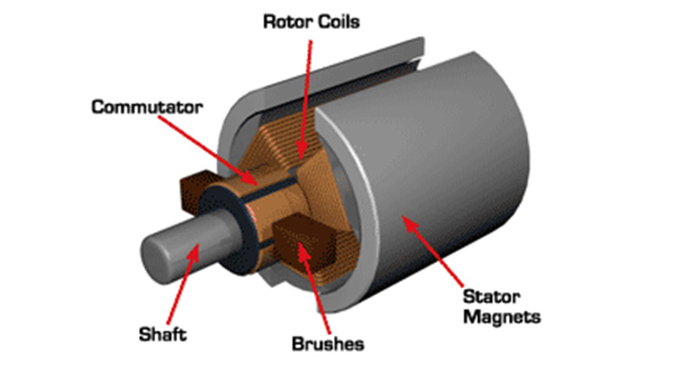
Structure of a DC motor

Slide 93
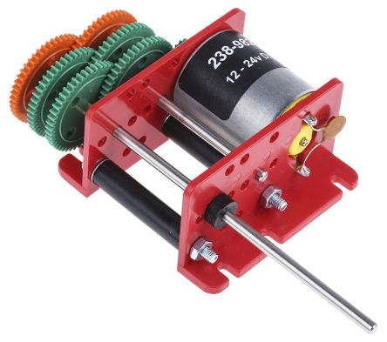
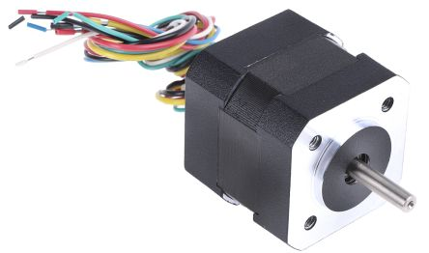
Types of DC Motors(contd)
Brushed DC Motor:-
Brushless DC Motor:-

Slide 94
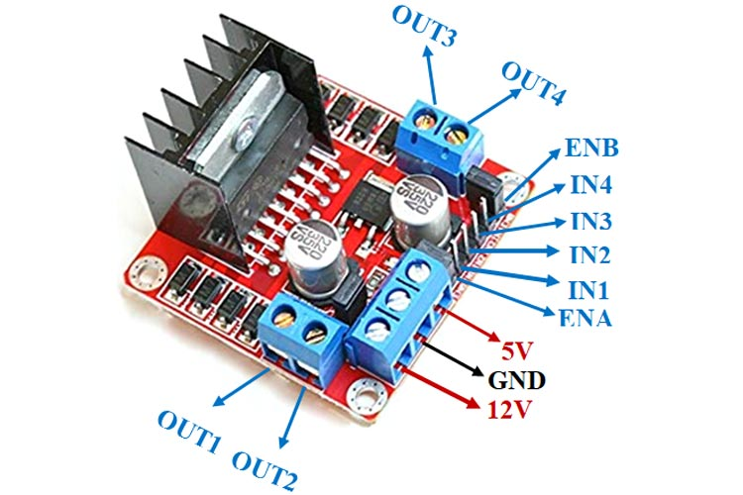
Motor Driver Module(L298N)

Slide 95
Motor Drivers(contd)
Motor drivers acts as an interface between the motors and the control circuits. Motors require high amount of current whereas the controller circuit works on low current signals. So the function of motor drivers is to take a low-current control signal and then turn it into a higher-current signal that can drive a motor.
We should not drive the motor directly from Arduino board pins. This may damage the board.
Reference: https://sproboticworks.com/blog/choosing-the-right-motor-driver#:~:text=Motor%20drivers%20acts%20as%20an,that%20can%20drive%20a%20motor.

Slide 96


Proteus Connection
Components Needed:

Slide 97
Code
int MotorForward = 7; // Pin 7 has Motor connected on Arduino boards.
int MotorReverse = 6; // Pin 6 has Motor connected on Arduino boards.
void setup()
{
Serial.begin(9600);
pinMode(MotorForward, OUTPUT);
pinMode(MotorReverse, OUTPUT);
}
void loop() {
// Forward
digitalWrite(MotorForward, HIGH);
digitalWrite(MotorReverse, LOW);
delay(2000);
// Reverse
digitalWrite(MotorReverse, HIGH);
digitalWrite(MotorForward, LOW);
delay(2000);
// Stop
digitalWrite(MotorReverse, LOW);
digitalWrite(MotorForward, LOW);
delay(2000);
}

Slide 98
Extra Materials
If you want to see the hardware version of DC motor+Arduino connection-
https://www.youtube.com/watch?v=Ey4xoG970Go&ab_channel=educ8s.tv
Working principle of DC motors-
https://www.youtube.com/watch?v=LAtPHANEfQo&ab_channel=Lesics

Slide 99
LDR (Light Dependent Resistor)

Slide 100


LDR Sensor

Slide 101
LDR
An LDR is a component that has a (variable) resistance that changes with the light intensity that falls upon it. This allows them to be used in light sensing circuits.
Light Dependent Resistors (LDR) are also called photoresistors. They are made of high resistance semiconductor material.
The resistance values of LDR in darkness are several megaohms whereas in bright light it will be dropped to hundred ohms.
More light=>less resistance
Less light=>more resistance

Slide 102


Proteus Connection
Components Needed:

Slide 103
Code
int ldr=A4;
int value = 0;
void setup() {
Serial.begin(9600);
}
void loop() {
value= analogRead(ldr);
Serial.println("Intensity of the LDR is =");
Serial.println(value);
delay(1000);
}

Slide 104
Add Libraries
Add the libraries for IR, PIR sensors to the library folder of Proteus Software:
In C:\ProgramData\Labcenter Electronics\Proteus 8 Professional\LIBRARY
OR
In C:\Program Files (x86)\Labcenter Electronics\Proteus 8 Professional\LIBRARY

Slide 105
THE END

